Slide 1
Spam Detection with Logistic Regression
DATA 606 - Email Spam- variable selection
Emmanuel Hayble-Gomes
November 20th, 2019

Slide 2

Email Filter-variable selection

Slide 3
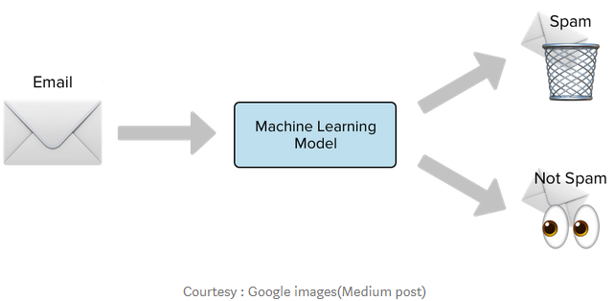
Openintro statistics- Problem: 9.21 Spam filtering, Part I.
Spam filters are built on principles similar to those used in logistic regression. We fit a probability that each message is spam or not spam. We have several email variables for this problem: to_multiple, cc, attach, dollar, winner, inherit, password, format, re_subj, exclaim_subj, and sent_email. We won't describe what each variable means here for the sake of brevity, but each is either a numerical or indicator variable.

Slide 4
The logistic regression model
For the Spam detection problem, we have tagged messages but we are not certain about new incoming messages. We will need a model which can tell us the probability of a message being Spam or Not Spam.
The logistic regression model relates the probability an email is spam (p_{i}) to the predictors x_{1, i}, x_{2, i} …, x_{k, i} through a framework much like that of multiple regression: transformation (pi) =β0 + β1x1,I + β2x2,I +…βkxk,i

Slide 5
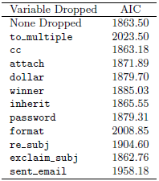
(a) For variable selection, we fit the full model, which includes all variables, and then we also fit each model where we've dropped exactly one of the variables. In each of these reduced models, the AIC value for the model is reported below. Based on these results, which variable, if any, should we drop as part of model selection? Explain.

Slide 6
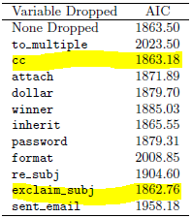
Solution
Using a Backward Elimination strategy, we look for models with a lower AIC (p 374).
For Part a, if exclaim_subj and cc variables are dropped or left out, the Model AIC is lowest at 1862.72 and 1863.18 respectively.

Slide 7
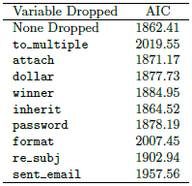
(b) Consider the following model selection stage. Here again we've computed the AIC for each leave-one-variable-out model. Based on the results, which variable, if any, should we drop as part of model selection? Explain.

Slide 8
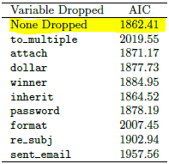
Solution
Similarly, For Part b, using the remaining 9 variables produced the lowest AIC at 1862.41 as indicated below.

Slide 9
Conclusion
The nine (9) variables from Part b are sufficient to build the Logistic Regression Model to address this problem of Email Spam filters.

Slide 10
Thank You!
Questions! Questions!! Questions!!!

